Slide 1
Course Overview
LECTURE 1
An overview of data science and the data science lifecycle
Data Science, Spring 2024 @ Knowledge Stream
Sana Jabbar

Slide 2
Intro – Sana Jabbar
BS Telecommunication Engineering @ FAST, Islamabad
MS Electrical Engineering @ FAST, Lahore
Since 2018 @ Lums, Research Associate in Computer Vision and Graphics Lab, formerly in Clinical and Translational Lab
Background: PhD Remote Sensing,
Research interests
Interactive computational tools for earth observation and medicine.
Applications in Remote Sensing for Taxation Automation.

Slide 3
What is Data Science?
Intros
What is data science?
The objective of this course?
Course Overview
Data Science Lifecycle
Lecture 01

Slide 4
What Is Data Science in this course?
PRINCIPLES AND TECHNIQUES OF DATA SCIENCE

Slide 5

What is Data Science?
Definition:
Data science is an interdisciplinary field that uses scientific methods, processes, algorithms, and systems to extract insights and knowledge from structured and unstructured data.
Data Science is the application of data centric, computational, and inferential thinking to:
Understand the world (science).
Solve problems (engineering).
Joey Gonzalez

Slide 6
What is Data Science?
Definition:
Data science is an interdisciplinary field that uses scientific methods, processes, algorithms, and systems to extract insights and knowledge from structured and unstructured data.
Interdisciplinary Nature:
Data science combines elements of computer science, mathematics, and domain expertise to solve complex problems.
Structured Data:
Refers to data that is organized into a specific format, typically consisting of rows and columns, where each piece of information is stored in a well-defined manner.
Unstructured Data:
Refers to data that lacks a specific, predefined structure, making it more challenging to organize and analyse compared to structured data.
Notes:
Examples of structured data include databases of customer information,
spreadsheets, and tables containing financial data, such as stock prices and sales figures.
Examples of unstructured data include social media posts, email messages, handwritten notes, images, voice recordings, and video content.

Slide 7
Objective
Intros
What is data science?
The objective of this course?
Course Overview
Data Science Lifecycle
Lecture 01

Slide 8
Course Objective
PRINCIPLES AND TECHNIQUES OF DATA SCIENCE

Slide 9
Course Objective
Course Objectives:
Equip students with the skills needed to extract valuable insights from data.

Slide 10

Course Objective
Course Objectives:
Equip students with the skills needed to extract valuable insights from data.
Data Collection
Notes:
You will learn how to acquire data from diverse sources, including databases, web APIs, and sensor networks.
For instance, to understand how to retrieve financial market data from APIs like Yahoo Finance or extract social media data for sentiment analysis.

Slide 11
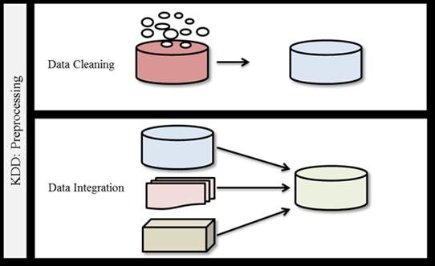
Course Objective
Course Objectives:
Equip students with the skills needed to extract valuable insights from data.
Data Cleaning
Data Collection
Data Integration
Notes:
You will become adept at handling real-world data, which often contains missing values, outliers, and inconsistencies.
They will apply techniques to clean and preprocess data, ensuring it's suitable for analysis.
For example, they will know how to clean a dataset containing customer information by handling missing values and removing duplicates.

Slide 12
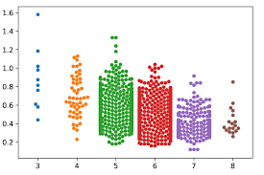
Course Objective
Course Objectives:
Equip students with the skills needed to extract valuable insights from data.
Data Cleaning
Data Collection
Exploratory Data Analysis
Data Integration
Notes:
EDA techniques are to unveil hidden patterns, relationships, and outliers within datasets.
Data can be visualize effectively using libraries like Matplotlib and Seaborn.
Example: For instance, create visualizations to understand the distribution of house prices in a real estate dataset.

Slide 13
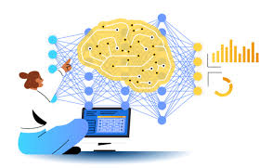
Course Objective
Course Objectives:
Equip students with the skills needed to extract valuable insights from data.
Data Cleaning
Data Collection
Exploratory Data Analysis
Machine Learning
Data Integration
Notes:
You will delve into machine learning algorithms, both supervised and unsupervised, and understand when and how to apply them.
You will build predictive models for tasks like image classification, recommendation systems, and fraud detection.

Slide 14
Course Objective
Course Objectives:
Equip students with the skills needed to extract valuable insights from data.
Data Cleaning
Data Collection
Exploratory Data Analysis
Machine Learning
Data Integration
Prepare students for real-world data science challenges.
Effectively communicate their findings to non-technical stakeholders
Notes:
Lastly, students will learn how to effectively communicate their findings to non-technical stakeholders through data visualization, storytelling, and clear, concise reports.
They will present insights from data analyses in a way that informs decision-making.
For example, they may create a data-driven report for a business client outlining marketing strategies based on customer behavior data

Slide 15
Course Objective
Prepare
Prepare students for data management, machine learning, and statistics, by providing the necessary foundation and context.
Enable students to start careers as data scientists by providing experience working with real-world data, tools, and techniques.
Enable
Empower
Empower students to apply computational and inferential thinking to address real-world problems.

Slide 16
Importance of Data Science
Data science drives decision-making across various industries.
There is a high demand for data scientists in today's job market.
Data is used everywhere to answer hard questions and make tough decisions:
Science
Medicine
Engineering
Sports
The world is complicated! Decisions are hard.
Claims about data come up in discussing almost any important issue:
Instead of ”Alex says," now it’s "the data says."
It is usually not easy to tell what the data "says"
Empower yourself to participate in the arguments that shape your life and your society

Slide 17
Importance of Data Science
Course Objectives:
Equip students with the skills needed to extract valuable insights from data.
Data Cleaning
Data Collection
Exploratory Data Analysis
Machine Learning
Data Integration
Prepare them for real-world data science challenges.
Effectively communicate their findings to non-technical stakeholders
Example:
Imagine you work for an e-commerce
Notes:
Imagine you work for an e-commerce company, and you have access to a vast amount of customer data, including purchase history, browsing behavior, and demographics.
Equipped with the skills from this course, you would be able to analyze this data to:
Identify customer segments with similar buying habits, helping the company personalize marketing campaigns.
Detect anomalies in payment transactions to prevent fraudulent activities.
Predict which products are likely to be purchased together to optimize product recommendations and increase cross-selling opportunities.

Slide 18
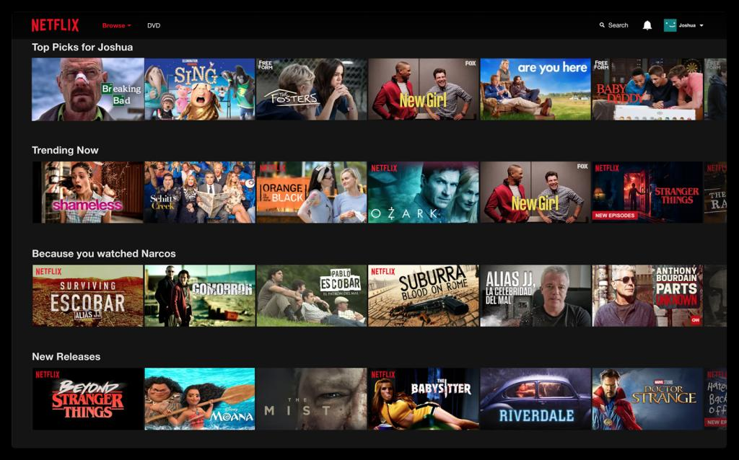

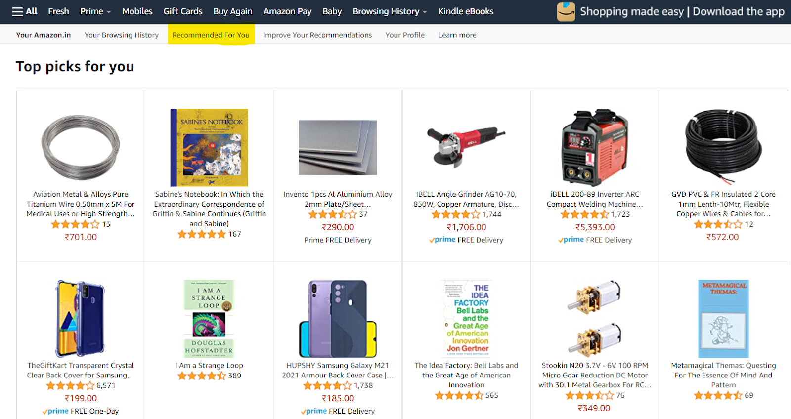

Recommendation Systems

Slide 19
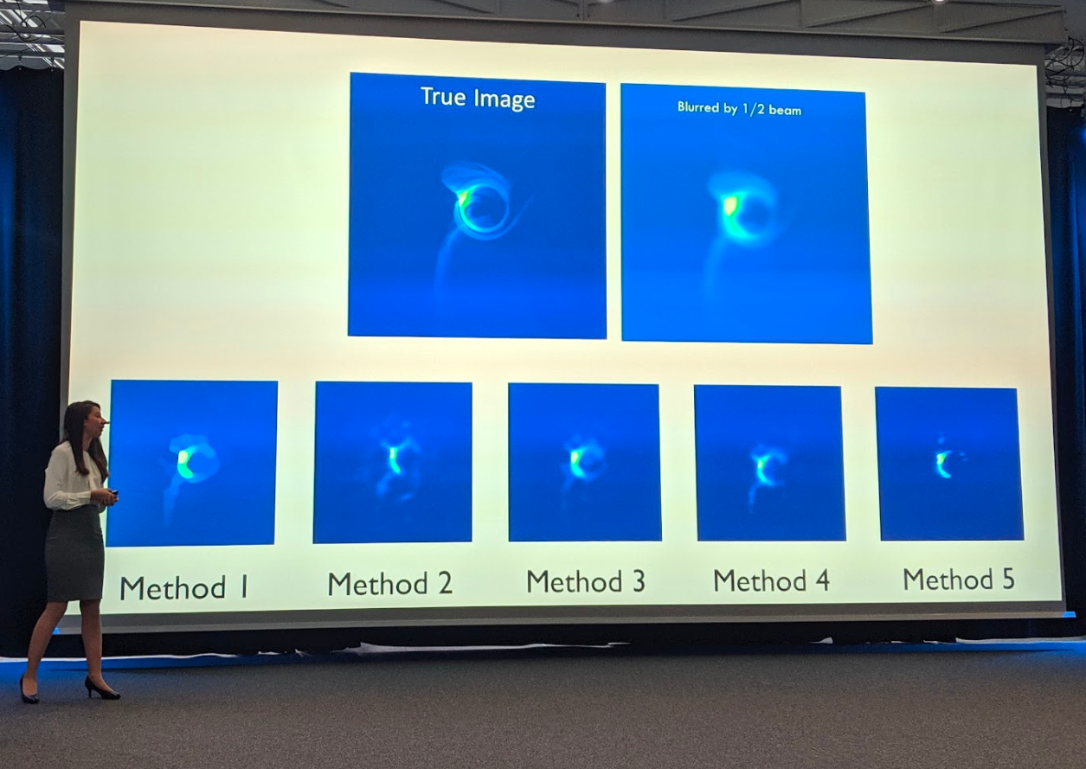
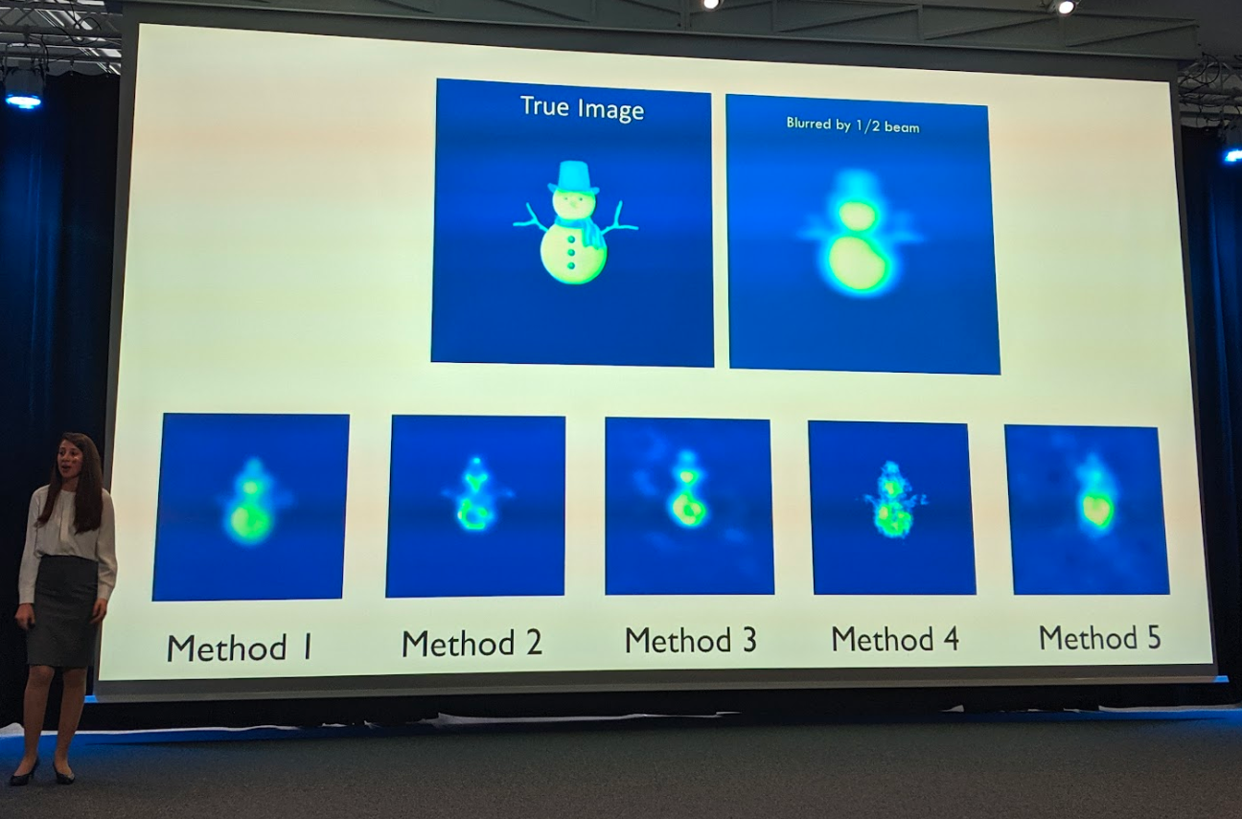
First Image of a Black Hole

Slide 20
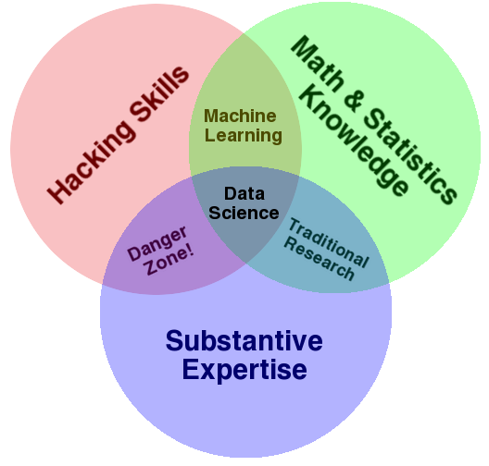
Data Science Venn Diagram
by Drew Conway in 2010

Slide 21
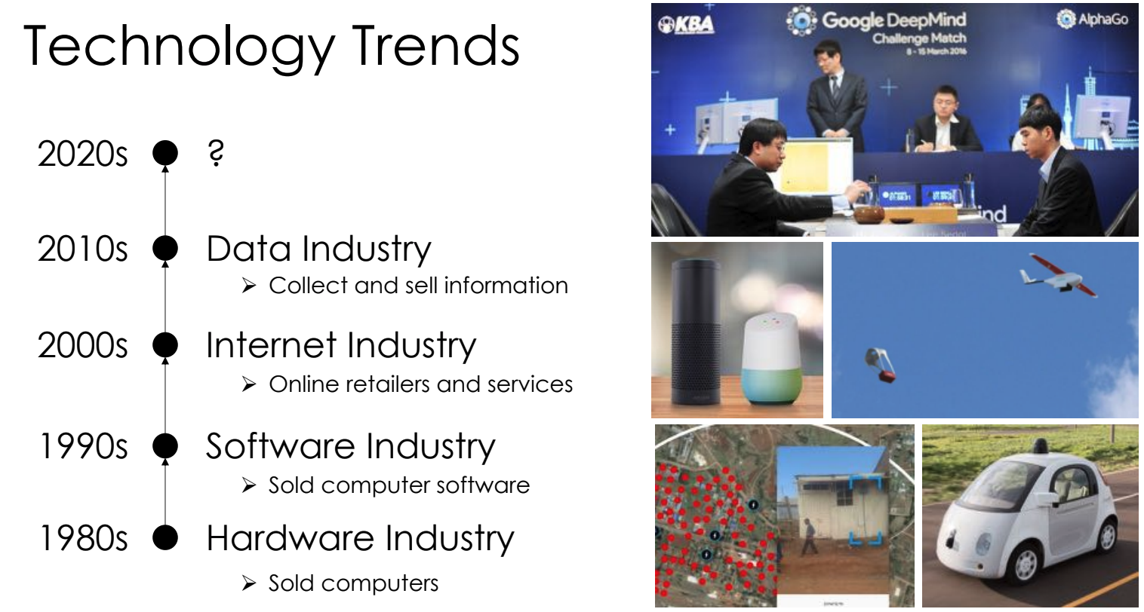
Importance of Data Science
AI…?
From Joey Gonzalez.
https://en.wikipedia.org/wiki/AlphaGo_versus_Lee_Sedol

Slide 22
Data!
Knowledge is empowering.
Data science offers immense potential to address challenging problems facing society.
The future is in your hands, and I believe:
You will use your knowledge for good.
…I am thrilled to teach Data Science :-)

Slide 23
Importance of Data Science
The world is complicated! Decisions are hard.
Data science is a fundamentally human-centered field that facilitates decision-making by quantitatively balancing tradeoffs.
To quantify things reliably we must:
Find relevant data;
Recognize its limitations;
Ask the right questions;
Make reasonable assumptions;
Conduct an appropriate analysis; and
Synthesize and explain our insights.
Apply critical thinking and skepticism at every step
Consider how our decisions affect others.

Slide 24
Importance of Data Science
The world is complicated! Decisions are hard.
Data science is a fundamentally human-centered field that facilitates decision-making by quantitatively balancing tradeoffs.
To quantify things reliably we must:
Find relevant data;
Recognize its limitations;
Ask the right questions;
Make reasonable assumptions;
Conduct an appropriate analysis; and
Synthesize and explain our insights.
Apply critical thinking and skepticism at every step
Consider how our decisions affect others.
After this course, you should be able to take data and produce useful insights on the world’s most challenging and ambiguous problems.

Slide 25
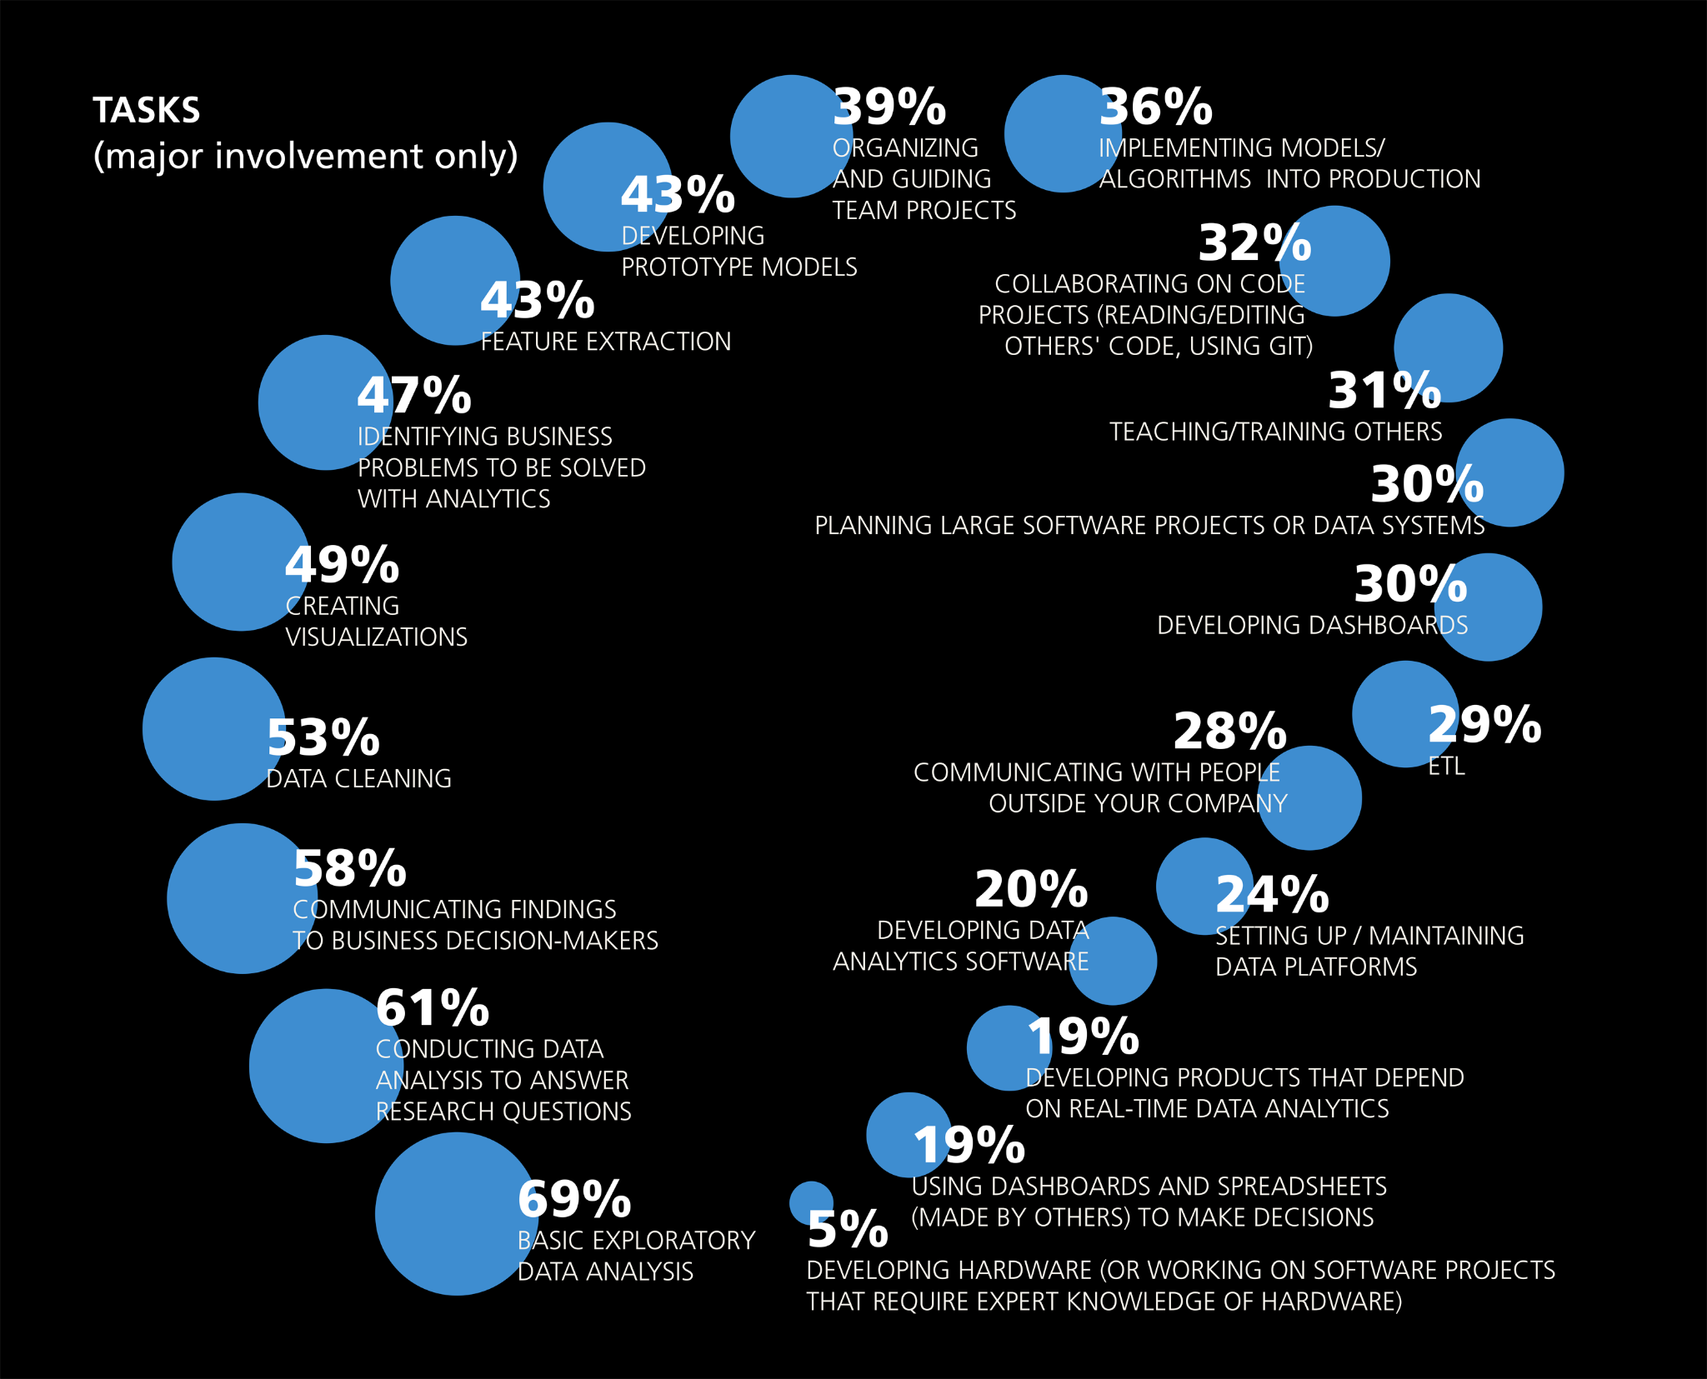
Importance of Data Science
The major tasks that data scientists say they work on regularly.
Based on the results of the 2016 Data Science Salary Survey.
Notes:
In industry
69% Basic EDA
43% Feature Extraction, Developing prototype models

Slide 26
Importance of Data Science
The major tasks that data scientists say they work on regularly.
Based on the results of the 2016 Data Science Salary Survey.
Notes:
In industry
69% Basic EDA
43% Feature Extraction, Developing prototype models

Slide 27
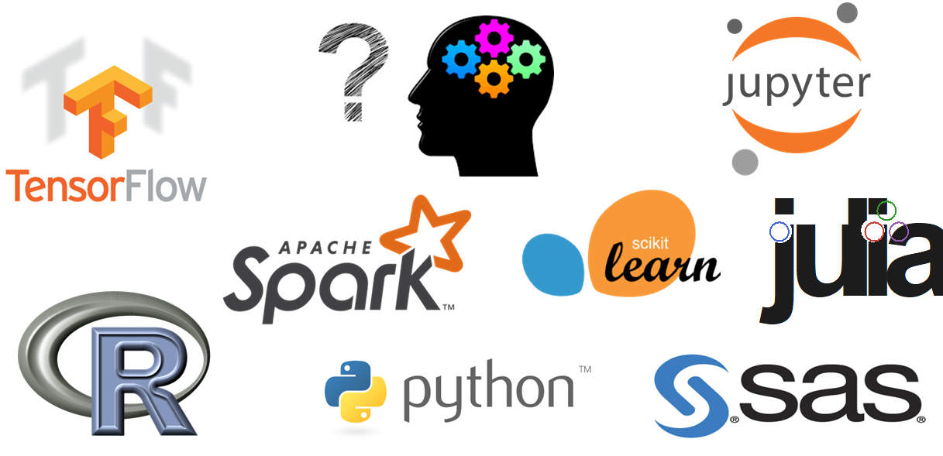
Data Science Requires Engineering and Scientific Insight
Good data analysis is not:
The simple application of a statistics recipe.
Simple application of statistical software.
There are many tools out there for data science, but they are merely tools.
They don’t do any of the important thinking!
“The purpose of computing is insight, not numbers.”
R. Hamming. Numerical Methods for Scientists and Engineers (1962).

Slide 28
Example Questions in Data Science
Some (broad) questions we might try to answer with data science:
What show should we recommend to our users to watch?
In which markets should we focus our advertising campaign?
Should I send my kids to daycare?
Is the world getting better or worse?
What areas of the world are at higher risk for climate change impact in 10 years? 20?
What should we eat to avoid dying early of heart disease?
Do immigrants from poor countries have a positive or negative impact on the economy?
Which university will be the most appropriate for Data science engineering?

Slide 29
Course Overview
Intros
What is data science?
The objective of this course?
Course Overview
Data Science Lifecycle
Lecture 01

Slide 30









Tentative List of Topics to be Covered in Data Science
Pandas and NumPy
Relational Databases & SQL
Exploratory Data Analysis
Regular Expressions
Visualization
matplotlib
Seaborn
plotly
Sampling
Model design and loss formulation
Linear Regression
Feature Engineering
Regularization, Bias-Variance Tradeoff, Cross-Validation
Gradient Descent
Data science in the physical world
Logistic Regression
Clustering
PCA

Slide 31
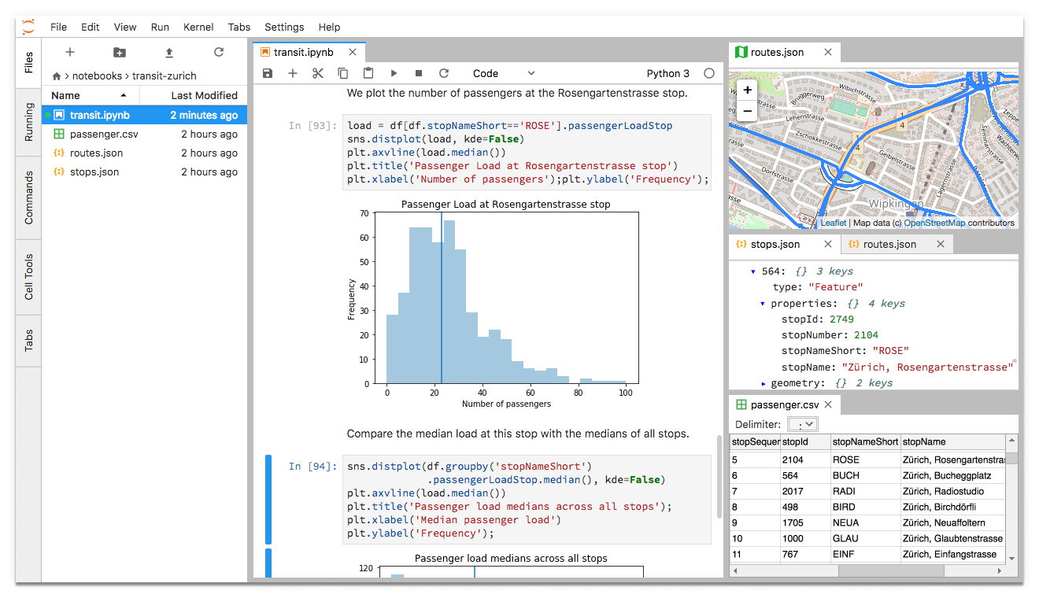
Programming Environment for our Course: Jupyter Notebook

Slide 32
Data Science Lifecycle
Intros
What is data science?
The objective of this course?
Course Overview
Data Science Lifecycle
Lecture 01

Slide 33
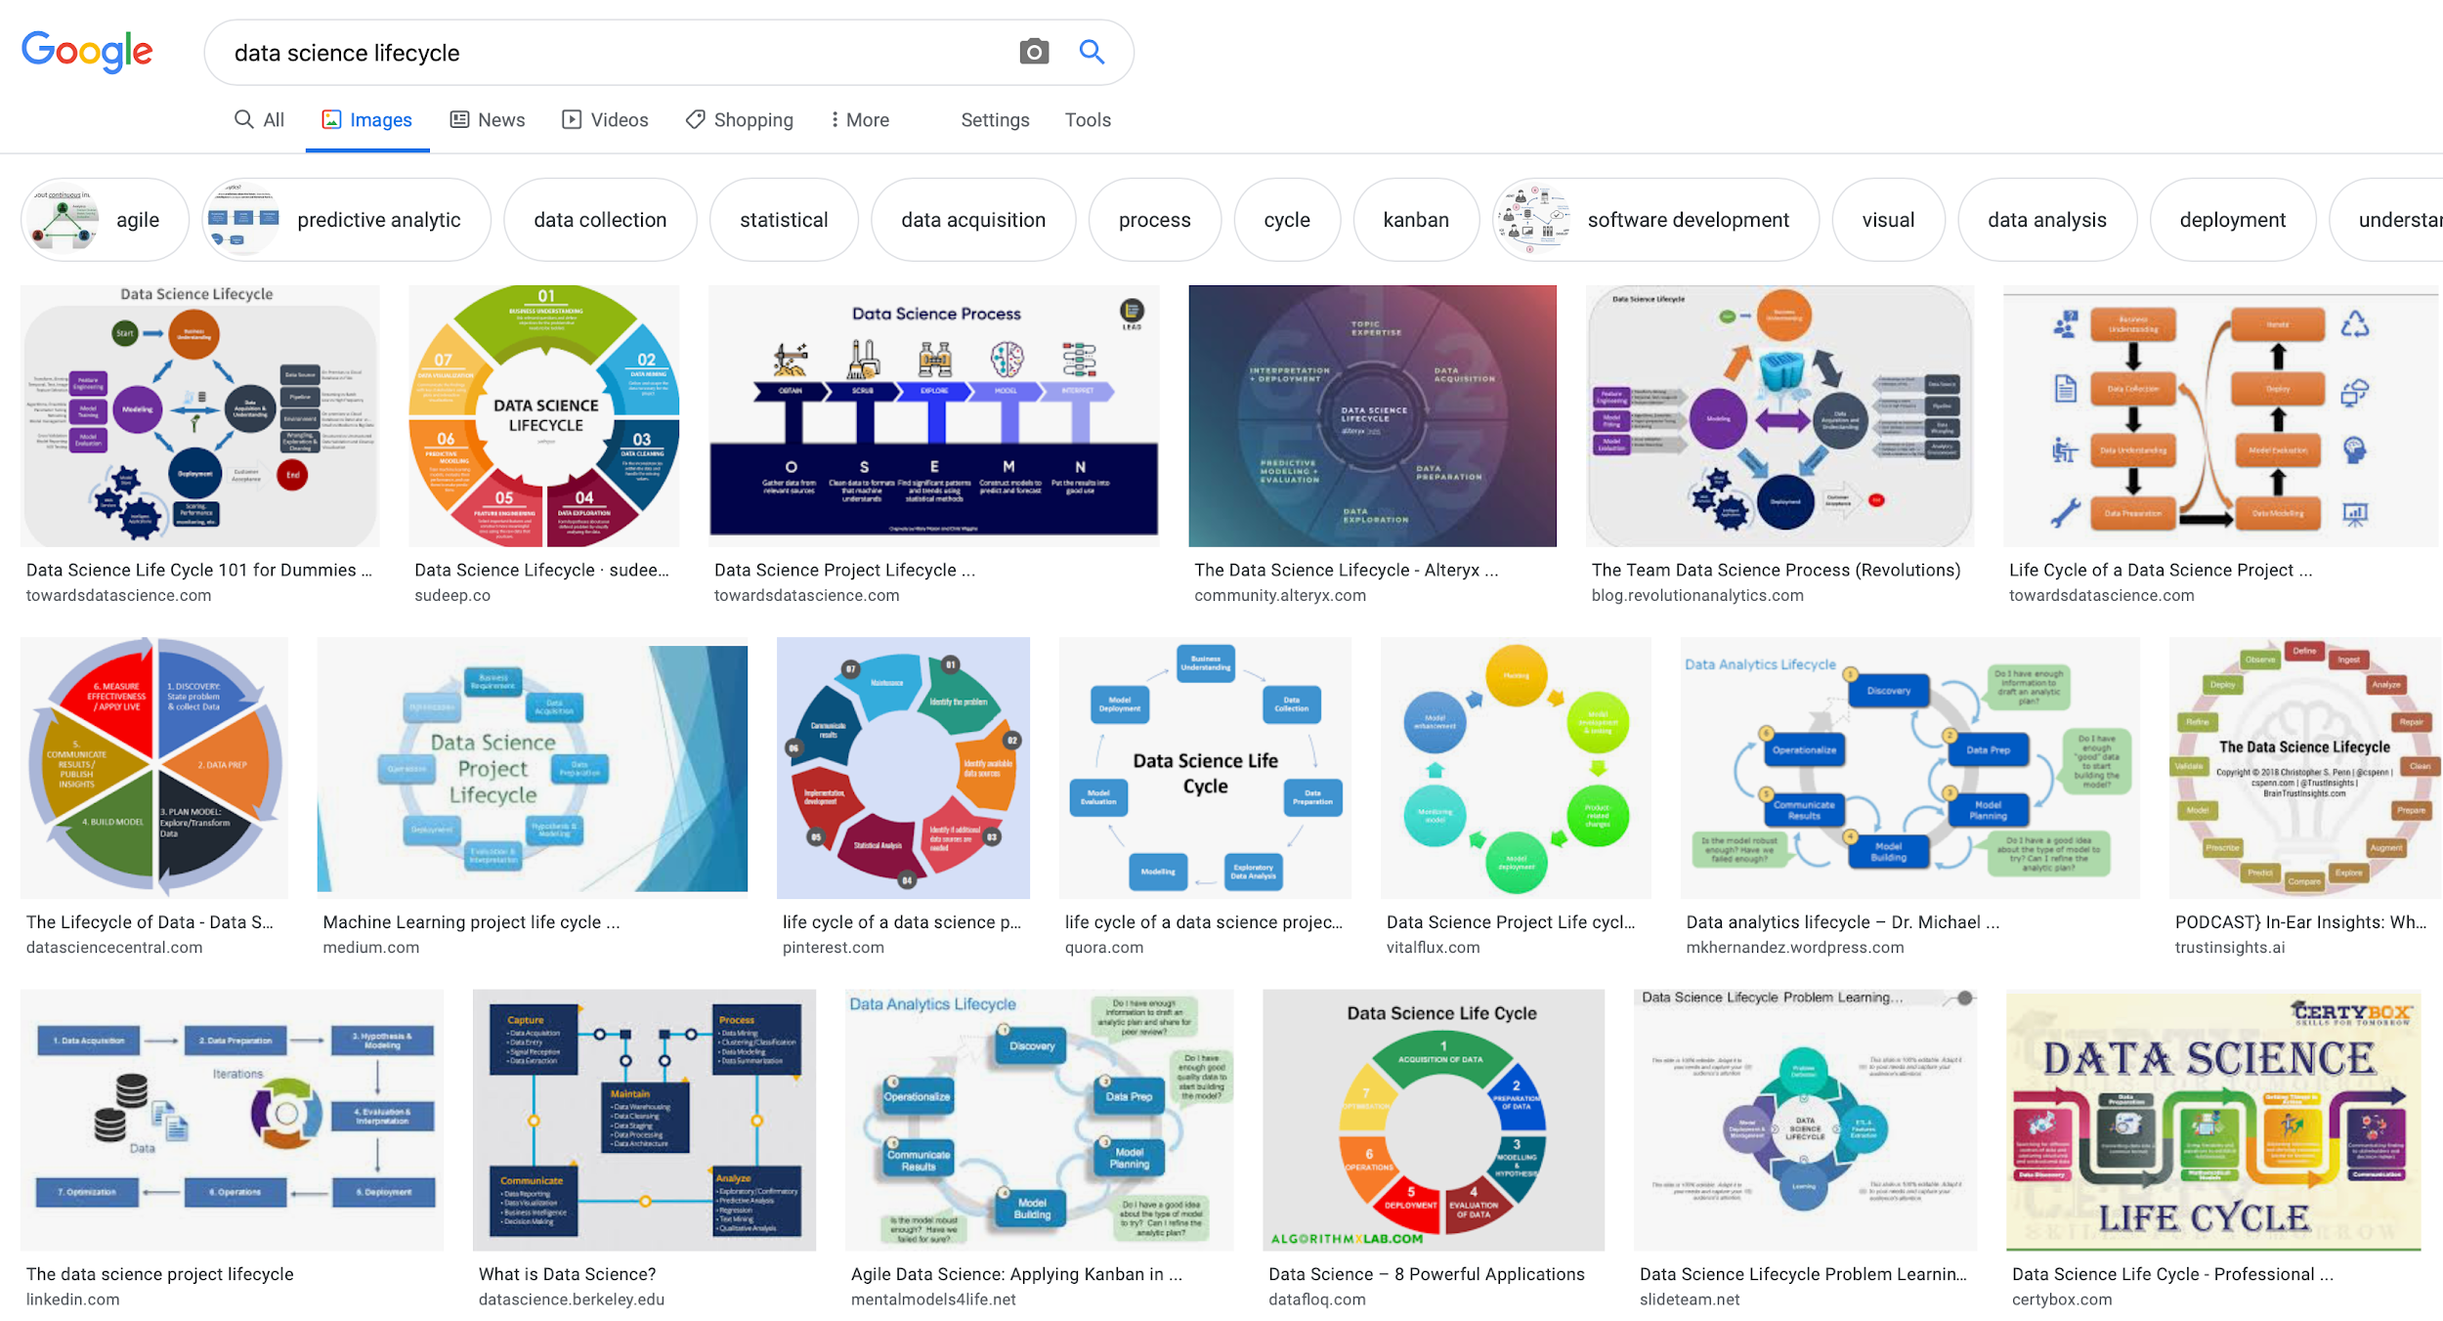
Data Science Lifecycle
The “data science lifecycle” you will see out in the wild may be slightly different than the one we teach you, but the core ideas are all the same.

Slide 34
Data Science Lifecycle
The data science lifecycle is a high-level description of the data science workflow.
Note the two distinct entry points!
Ask a Question
Obtain Data
Understand the World
Understand the Data
Reports, Decisions, and Solutions

Slide 35
1. Question/Problem Formulation
What do we want to know?
What problems are we trying to solve?
What hypotheses do we want to test?
What are our metrics for success?
Ask a Question
Obtain Data
Understand the World
Understand the Data
Reports, Decisions, and Solutions

Slide 36
2. Data Acquisition and Cleaning
What data do we have and what data do we need?
How will we sample more data?
Is our data representative of the population we want to study?
Ask a Question
Obtain Data
Understand the World
Understand the Data
Reports, Decisions, and Solutions

Slide 37
3. Exploratory Data Analysis & Visualization
How is our data organized and what does it contain?
Do we already have relevant data?
What are the biases, anomalies, or other issues with the data?
How do we transform the data to enable effective analysis?
Ask a Question
Obtain Data
Understand the World
Understand the Data
Reports, Decisions, and Solutions

Slide 38
4. Prediction and Inference
What does the data say about the world?
Does it answer our questions or accurately solve the problem?
How robust are our conclusions and can we trust the predictions?
Ask a Question
Obtain Data
Understand the World
Understand the Data
Reports, Decisions, and Solutions

Slide 39
Setup Framework!

